Slide 1
HALLOWEEN!!!
BY AKHIL OF 3C
BOOO !!!!

Slide 2
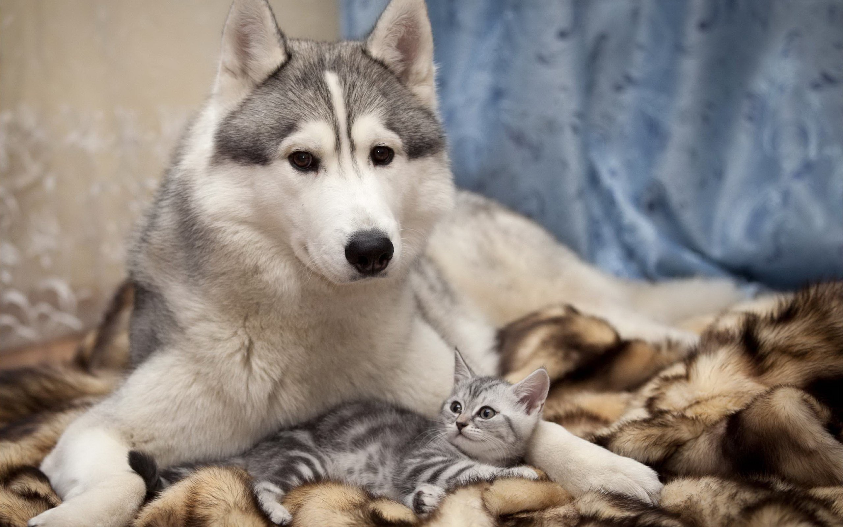
I know its cute
This Photo by Unknown Author is licensed under CC BY-SA

Slide 3
Pictures to guess this Topic!!!

Slide 4
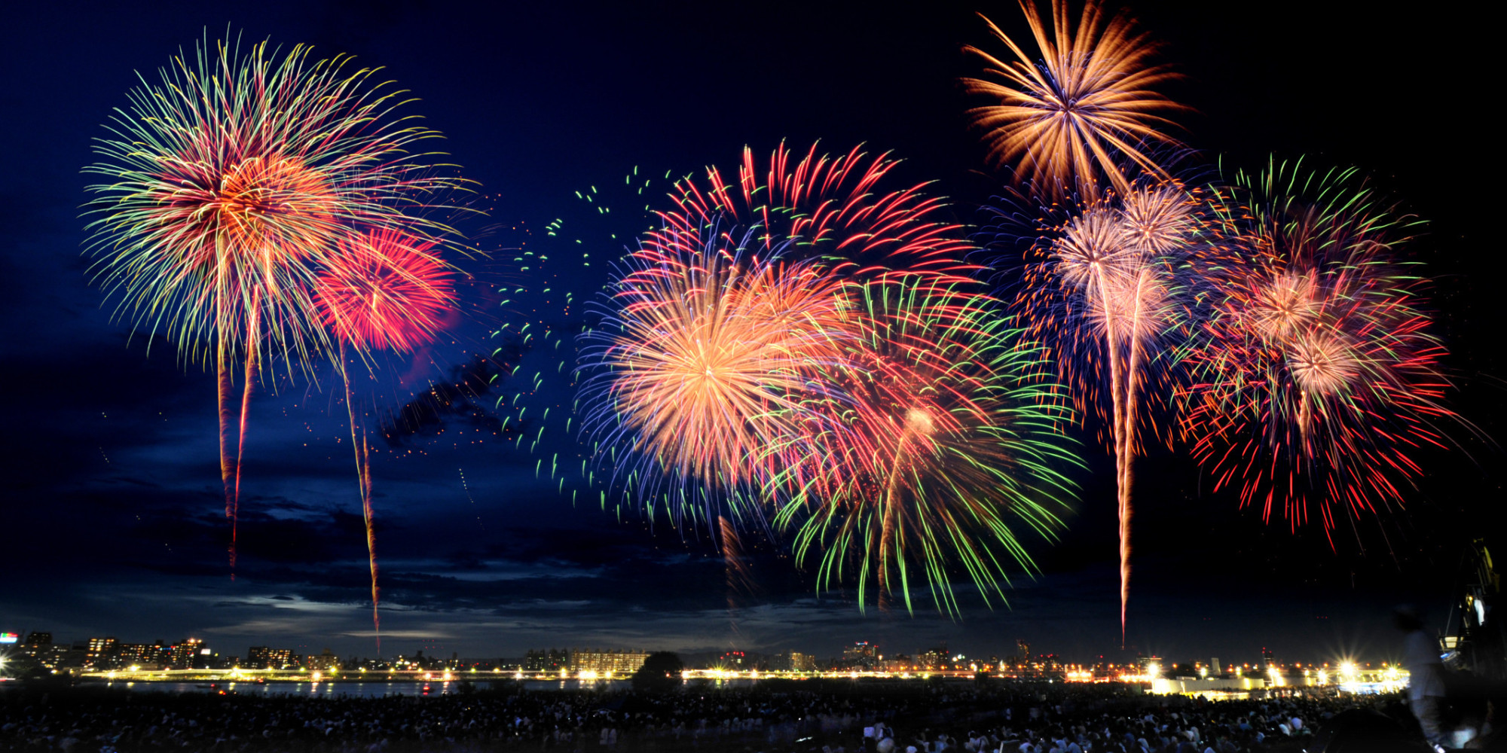
Guess what’s this?
This Photo by Unknown Author is licensed under CC BY-NC-ND

Slide 5

Guess what’s this?
This Photo by Unknown Author is licensed under CC BY-SA

Slide 6
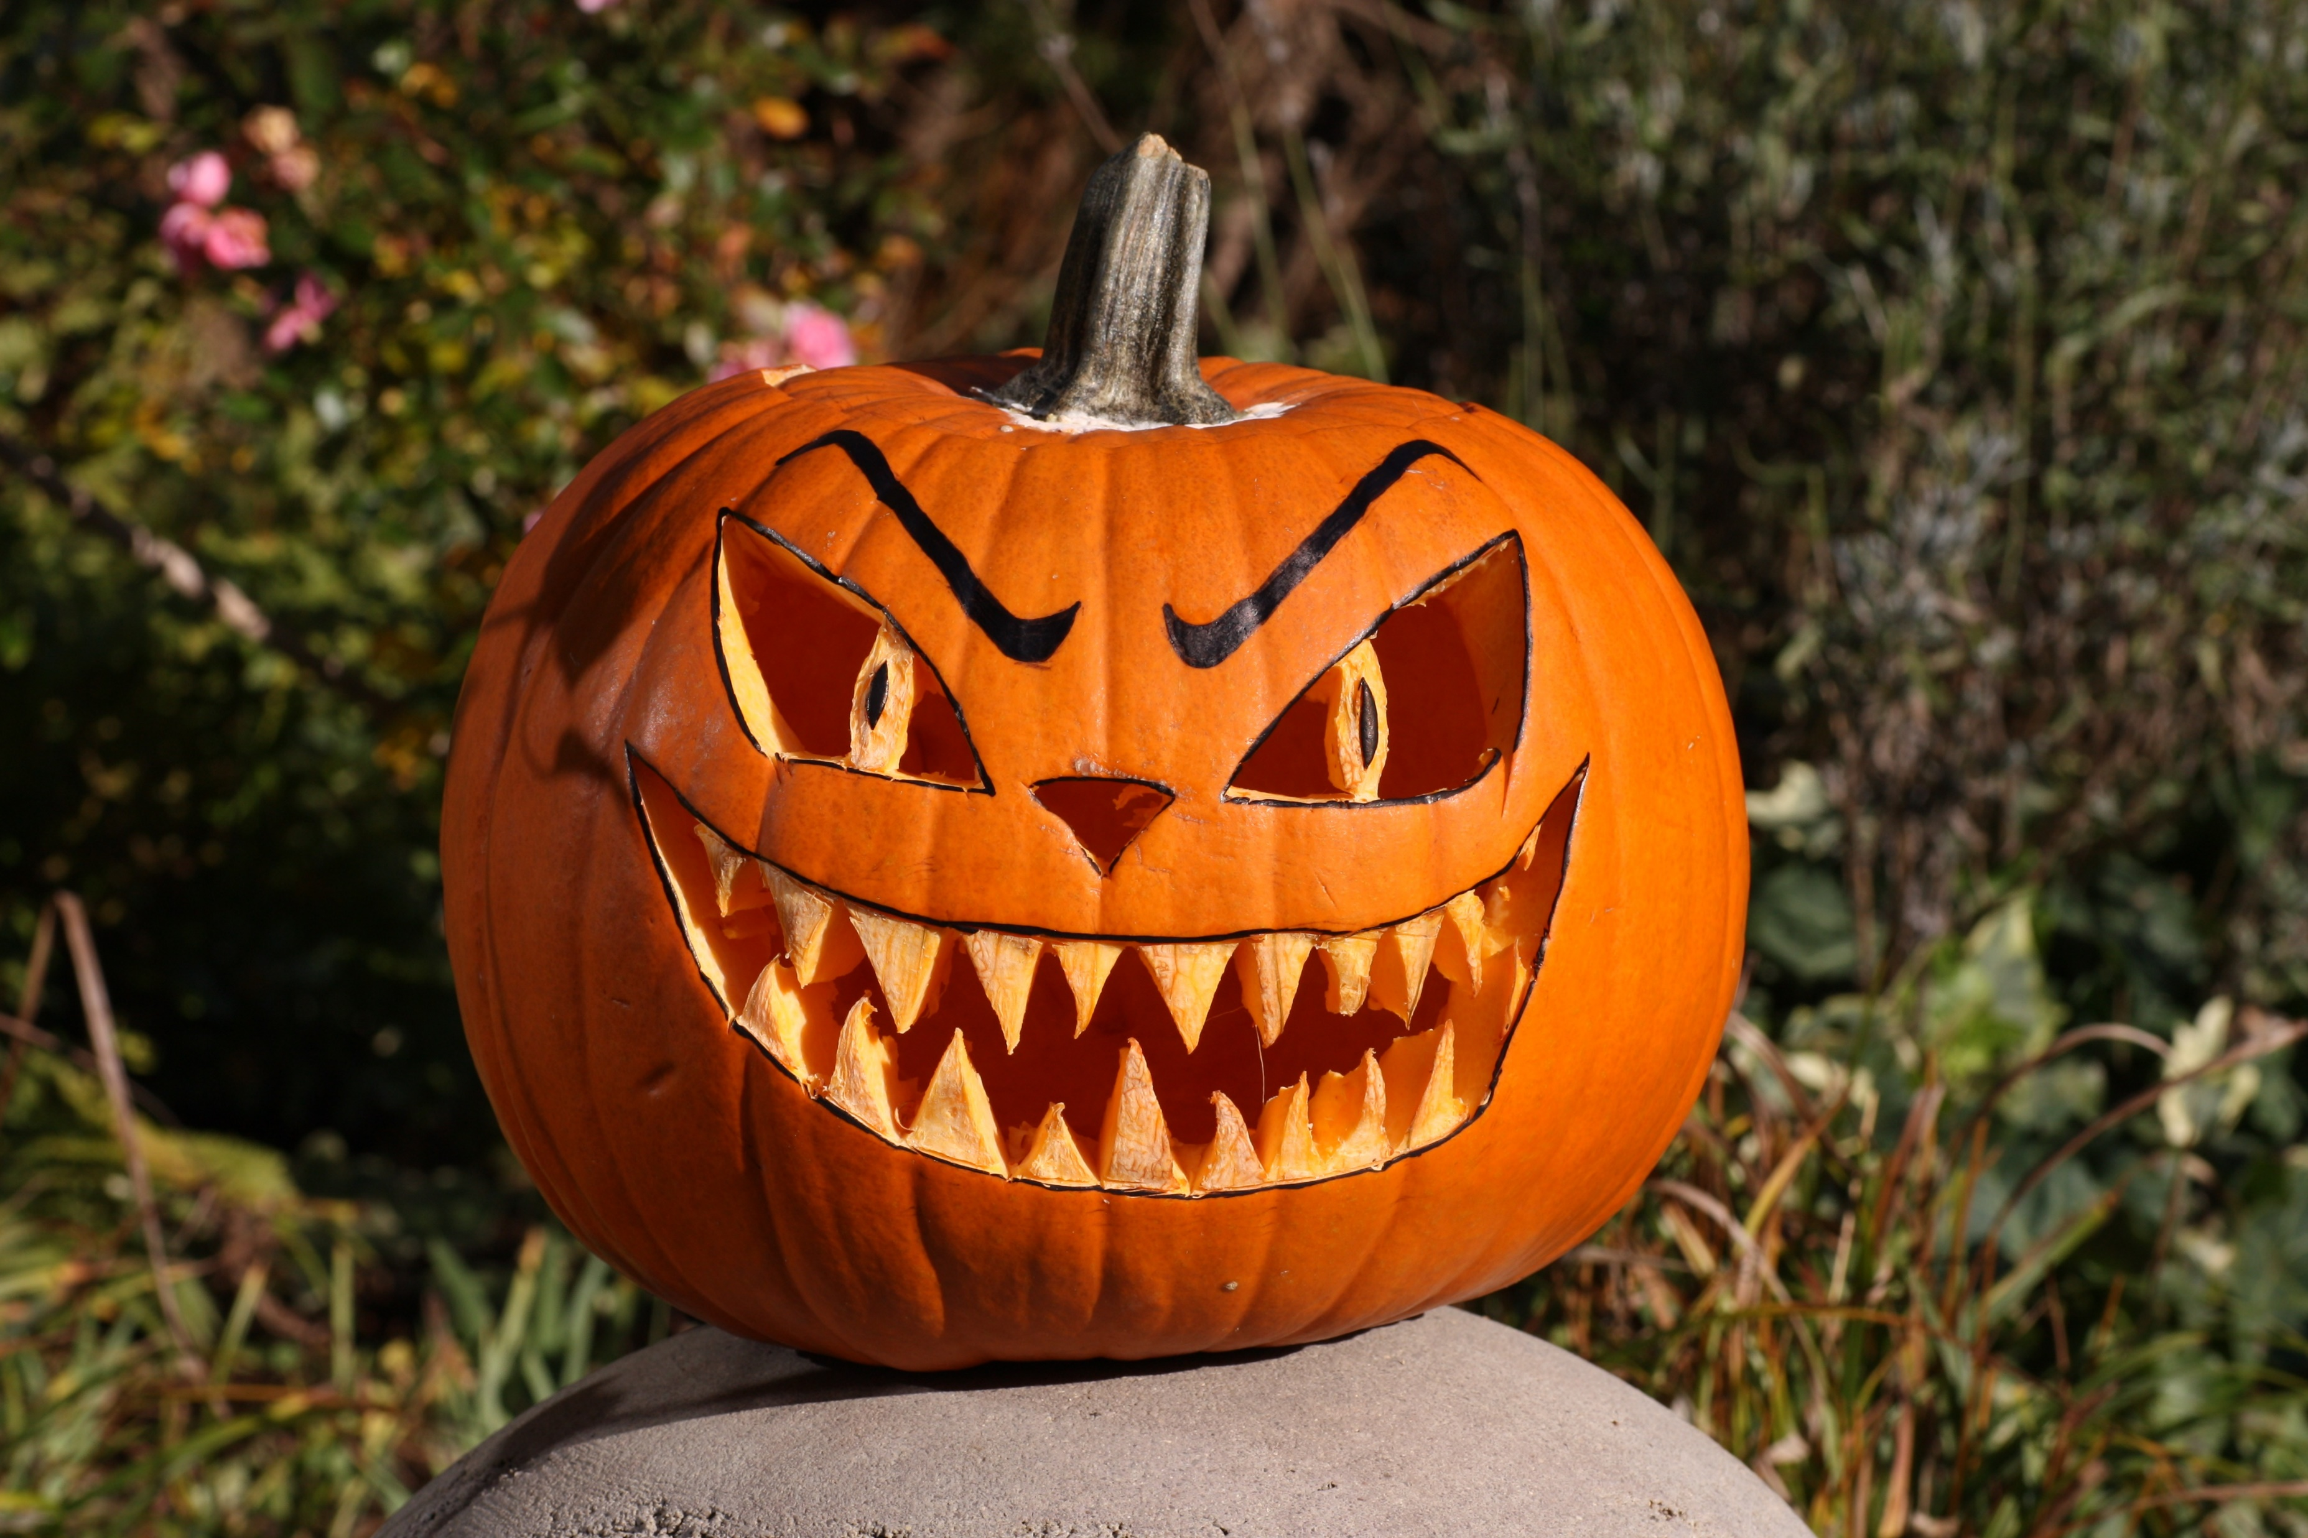
Guess what’s this?

Slide 7
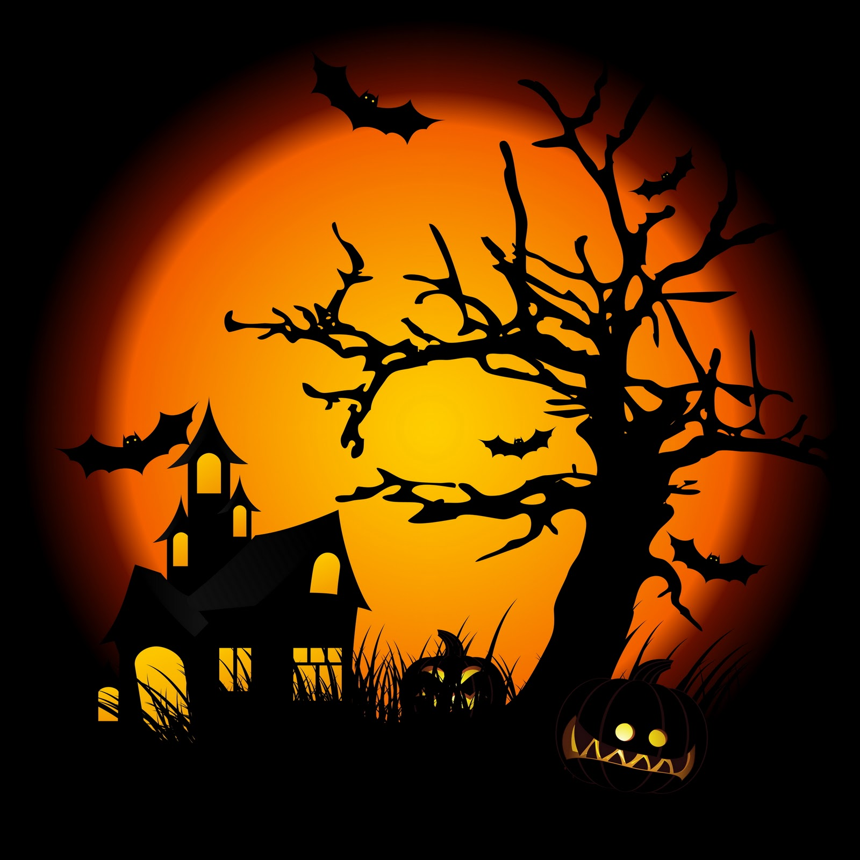
Guess what’s this?
This Photo by Unknown Author is licensed under CC BY-NC-ND

Slide 8
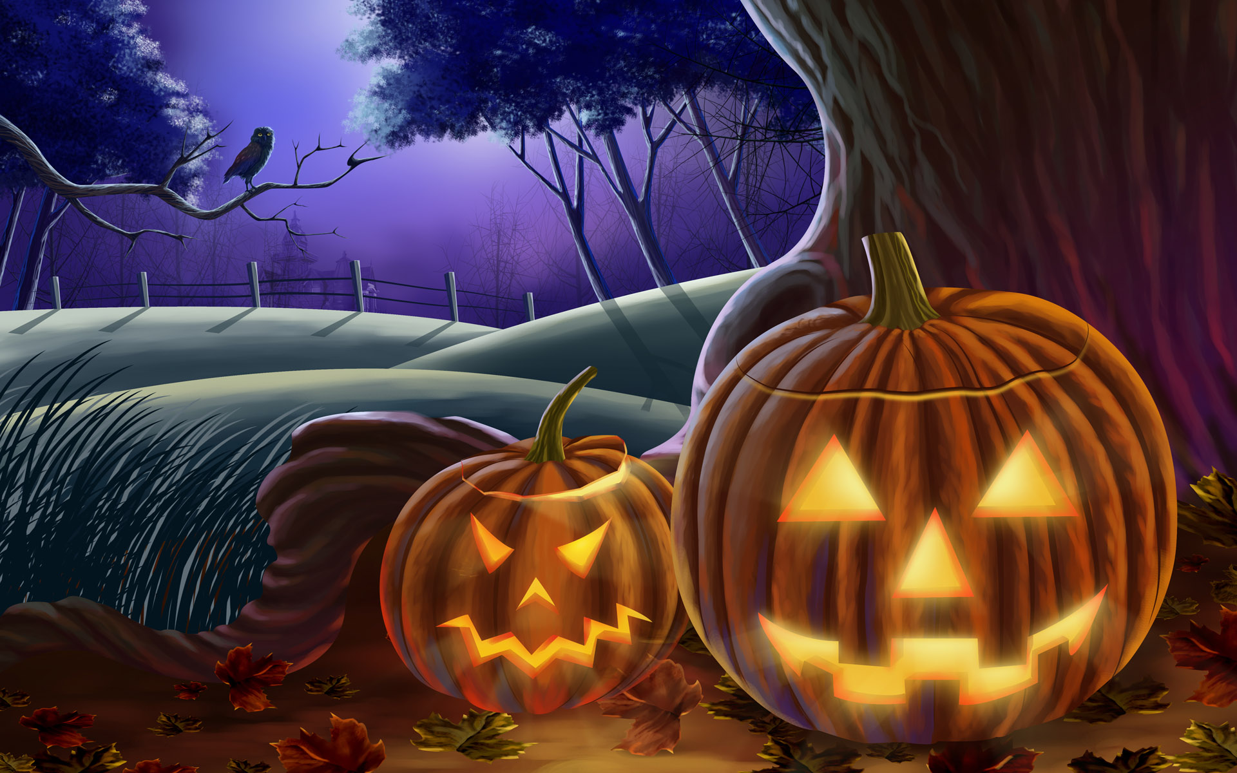
Guess what’s this?
This Photo by Unknown Author is licensed under CC BY-NC-ND

Slide 9
Answers!!
1. Festival
2. Halloween
3. Jack-O-Lantern
4. Haunted House
6. Graveyard

Slide 10
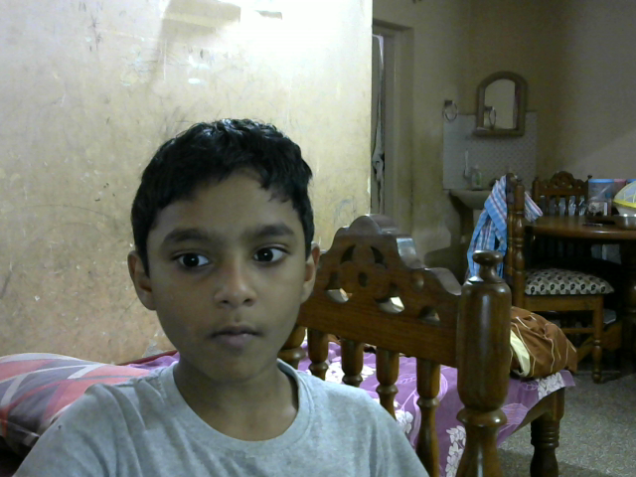
INFO ON HALLOWEEN!!!
Halloween activities include trick-or-treating (or the related guising and souling), attending Halloween costume parties, carving pumpkins into jack-o'-lanterns, lighting bonfires, apple bobbing, divination games, playing pranks, visiting haunted attractions, telling scary stories, as well as watching horror films.^{[21]} In many parts of the world, the Christian religious observances of All Hallows' Eve, including attending church services and lighting candles on the graves of the dead, remain popular,^{[22][23][24]} although elsewhere it is a more commercial and secular celebration.^{[25][26][27]} Some Christians historically abstained from meat on All Hallows' Eve, a tradition reflected in the eating of certain vegetarian foods on this vigil day, including apples, potato pancakes, and soul cakes.

Slide 11
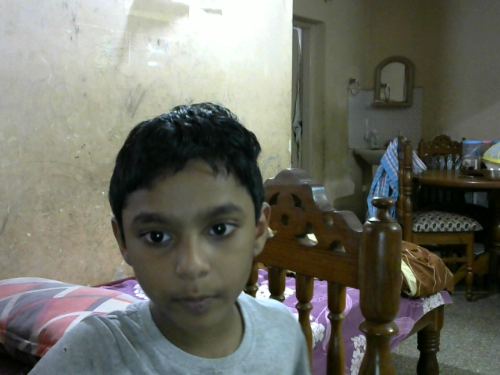
Halloween
Halloween
Halloween or Hallowe'en (a contraction of Hallows' Even or Hallows' Evening),^{[5]} also known as Allhalloween,^{[6]} All Hallows' Eve,^{[7]} or All Saints' Eve,^{[8]} is a celebration observed in many countries on 31 October, the eve of the Western Christian feast of All Hallows' Day. It begins the three-day observance of Allhallowtide,^{[9]} the time in the liturgical year dedicated to remembering the dead, including saints (hallows), martyrs, and all the faithful departed.^{[10][11]}

Slide 12
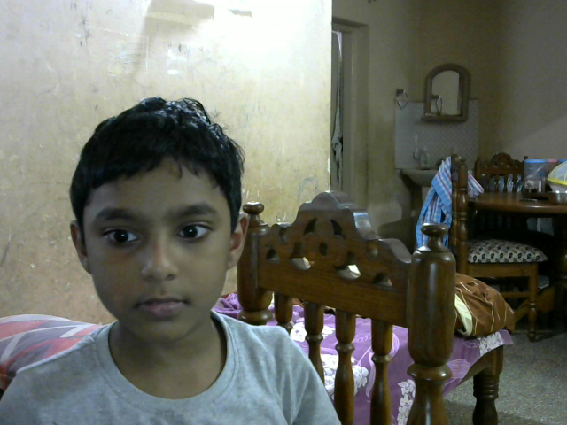
MORE!!!
It is widely believed that many Halloween traditions originated from ancient Celtic harvest festivals, particularly the Gaelic festival Samhain; that such festivals may have had pagan roots; and that Samhain itself was Christianized as Halloween by the early Church.^{[12][13][14][15][16]} Some believe, however, that Halloween began solely as a Christian holiday, separate from ancient festivals like Samhain.^{[17][18][19][20]}

Slide 13
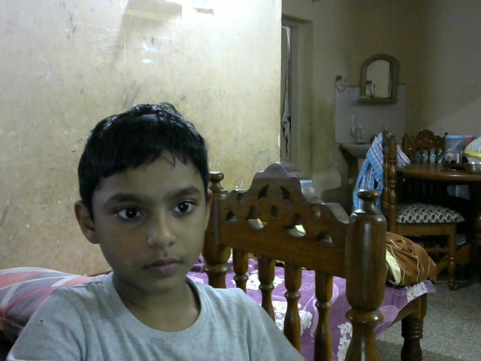
Here are some quizzes
Go to https://quizizz.com/join or https://quizizz.com/join/pre-game/running/U2FsdGVkX19nxenqZEr2bDoU93noElB8cEjz%252FgZEyulRXTpkyJ%252FaXi%252FHo%252F4SnE%252Bb20yq31qoWg8DMkxKvnildL3seJANDfHHzAIeuNC3Kqk%253D/start and enter the code given below.
58508608

Slide 14
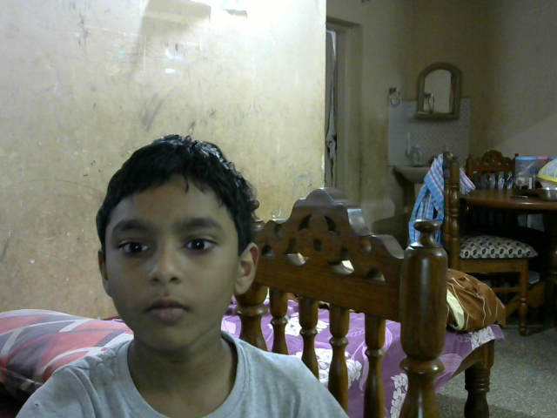
Now back to work
Halloween is a holiday celebrated each year on October 31, and Halloween 2020 will occur on Saturday, October 31. The tradition originated with the ancient Celtic festival of Samhain, when people would light bonfires and wear costumes to ward off ghosts. In the eighth century, Pope Gregory III designated November 1 as a time to honor all saints. Soon, All Saints Day incorporated some of the traditions of Samhain. The evening before was known as All Hallows Eve, and later Halloween. Over time, Halloween evolved into a day of activities like trick-or-treating, carving jack-o-lanterns, festive gatherings, donning costumes and eating treats.
READ MORE: Best Halloween Costume Ideas Inspired by History
Ancient Origins of Halloween

Slide 15
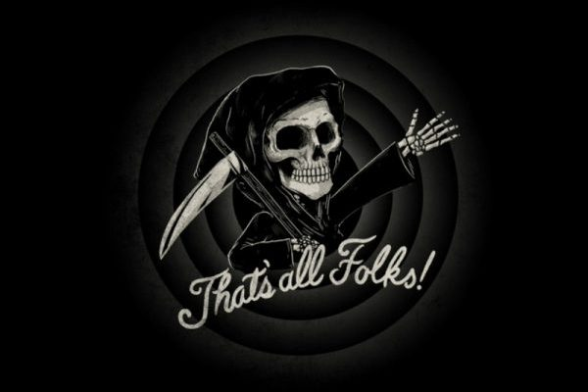
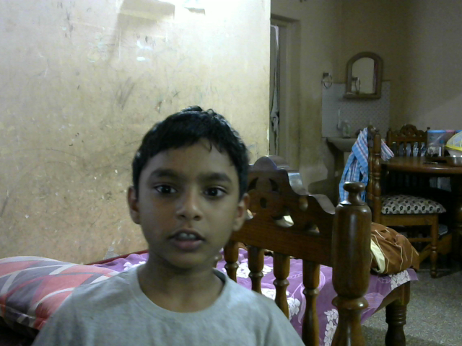
THE END!!!!
This Photo by Unknown Author is licensed under CC BY-ND

